Slide 1
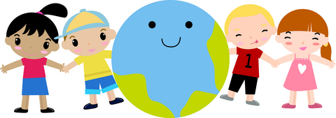
Fostering Self-Esteem in Children
*Adapted from lifelessonsforlittleones.com

Slide 2
Defining Self-Esteem
self-esteem is used to describe a person's overall sense of self-worth or personal value. Self-esteem can involve a variety of beliefs about the self, such as the appraisal of one's own appearance, beliefs, emotions and behaviors.

Slide 3
What is the daily ratio of positive, encouraging words that you say to your children, compared to the number of complaints, orders, criticisms, warnings, and discouraging words?

Slide 4
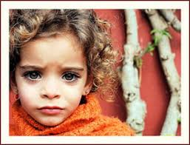
Research on Family Communication
Research has repeatedly confirmed the fact that we spend very little time actually talking with our children (less than 20 minutes a day, on average) and that when we do speak to them, it's more often to register a complaint, a command, or a request for assistance

Slide 5
It seems we're not talking with our children very much – and when we do say something to them, it's not likely to increase their sense of self-worth.
We can change this type of parent-child interaction by changing how and why we speak with our children every day.

Slide 6
Our focus must shift from reminding them and reprimanding them for what they are doing wrong, to reminding them and showing them how much they are loved, appreciated, and valued.
It doesn't mean that you don't tell them when they're wrong. But it does mean that we can't let them think that they are invisible except when they make a mistake.

Slide 7
Academic & Social Success
A child's feelings of self-worth are linked to social and academic success.
Research shows that children with learning disabilities are especially likely to suffer from a lack of self-esteem
All children benefit when their parents take steps to help them develop positive feelings of self-worth

Slide 8
How Can You Help?

Slide 9
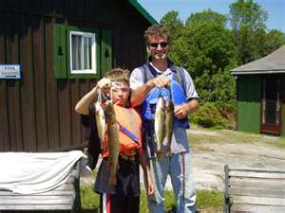
Help your child feel special and appreciated
Set aside "special times" during the week alone with each one of your children.
During these special times, focus on things that your child enjoys doing so that he or she has an opportunity to relax and to display his or her strengths.

Slide 10
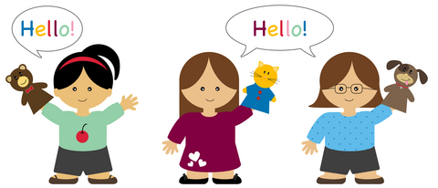
Help Your Child Develop Problem-Solving Skills
High self-esteem is associated with solid problem-solving skills.
For example, if your child is having difficulty with a friend, ask him or her to think of a couple of ways to solve the problem.
Role-playing situations with your child is a helpful way to demonstrate the steps involved in problem solving.

Slide 11
Avoid Comments that are Judgmental
For example, a comment that often sounds judgmental is, "Try harder and put in more of an effort.”
Many children do try hard and still have difficulty. Instead say, "We have to figure out better strategies to help you learn." Children are less defensive when the problem is cast as strategies that must be changed rather than as something deficient with their motivation. This approach also reinforces problem-solving skills

Slide 12
Be an Empathetic Parent
Well-meaning parents, out of their own frustration, have been heard to say such things as, "Why don't you listen to me?" or "Why don't you use your brain?"
If your child is having difficulty with learning, it is best to be empathetic and say to your child that you know he or she is having difficulty; then you can cast the difficulty into a problem to be solved and involve your child in thinking about possible solutions.

Slide 13
Provide Choices
This will also minimize power struggles. For example, ask your child if he or she would like to be reminded five or ten minutes before the bus arrives. These beginning choices help to set the foundation for a feeling of control over one's life.

Slide 14
Do Not Compare Siblings
It is important not to compare siblings and to highlight the strengths of all children in your family.

Slide 15
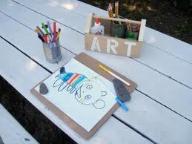
Highlight your Child's Strengths
Unfortunately, many children see themselves in a negative way, especially in terms of school.
Make a list of your child's areas of strength. Select one of these strengths and find ways of reinforcing and displaying it. For example, if your child is a wonderful artist, display his or her artwork.

Slide 16
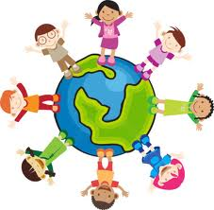
Provide Opportunities for Children to Help
Providing opportunities for children to help is a very concrete way of showing children that they have something to offer their world.
Involving your child in charitable work is just one possible example. Helping others certainly boosts your child's self-esteem

Slide 17
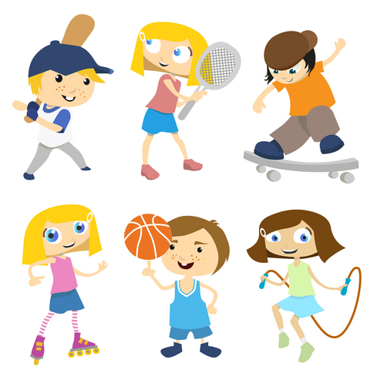
Have Realistic Expectations
Realistic expectations and goals provide your child with a sense of control.

Slide 18
Learning Disability
If your child has a learning disability, help your child to understand the nature of his or her learning disability.
Having realistic information can give your child a greater sense of control and a feeling that things can be done to help the situation.

Slide 19
Accentuating the positives should be at the core of your communication with your children. It should be your primary intention for talking with your kids.
Telling and showing our children how much we love and appreciate who they are can become a daily habit. Make an effort to do so every day.

Slide 20
Discussion
Questions?
Comments?

